Slide 1

Demystifying Transformers
A Beginner's Guide to the Key Terms

Slide 2
The Problem: Context is Everything
Consider this sentence: "The cat chased the rat, but it got away."
Who is "it"? The cat? The rat?
Humans know "it" is the rat. Early AI models struggled because they read word-by-word and would forget the "rat."
Transformers were built to read the entire sentence at once to understand this deep context, just like you do.

Slide 3

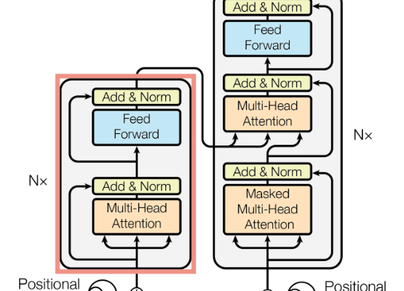
The Big Picture: Encoder & Decoder
The Encoder: The "Reader"
Its only job is to read the entire input sentence (e.g., "the quick brown fox") and build a deep, mathematical understanding of its meaning and context.
The Decoder: The "Writer"
Its job is to generate the output sentence word by word. As it writes, it "peeks" at the Encoder's understanding to stay on topic and provide a relevant response.

Slide 4
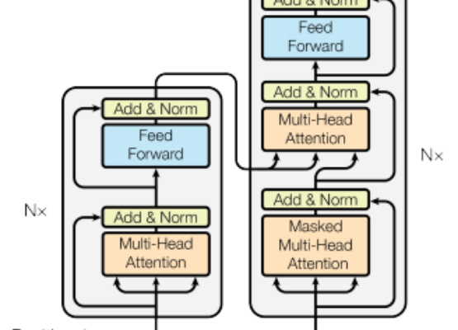
Key Term: The 'Stack' (e.g., N=6)
A "Stack" just means piling multiple identical layers on top of each other (e.g., 6, 12, or even 96 layers).
Analogy: Like stacking filters.
•
Layer 1: Understands basic words.
•
Layer 2: Understands phrases.
•
Layer 6: Understands complex meaning & intent.
Both the Encoder and Decoder are "Stacks" of their own layers.

Slide 5

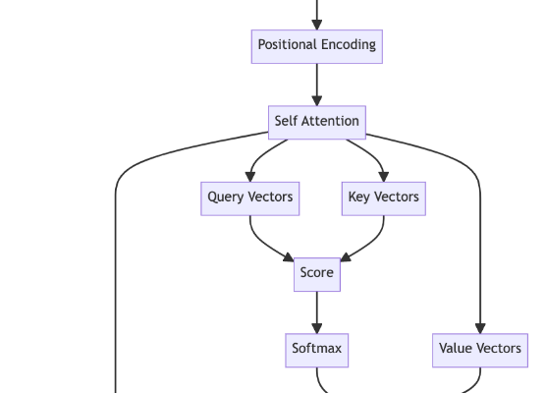
Key Term: 'Self-Attention'
This is the core mechanism of a Transformer. It's how the model "looks" at other words in the sentence to understand context.
Example: When processing the word "jumps" in...
"The quick brown fox jumps over the lazy dog."
Self-Attention allows the word "jumps" to pay more attention to "fox" (who is jumping) and "dog" (what is being jumped over).

Slide 6






Key Term: The 'Head'
What is a "Head"?
Multi-Head Attention
Parallel Experts
A "Head" is one "expert" at understanding context. But one expert isn't enough to capture the richness of language.
We use "Multi-Head" (e.g., 8 or 12 Heads) to create a "committee of experts" that analyze the text at the same time.
Head 1 might track who does what (fox -> jumps). Head 2 might track where (jumps -> over). Together, they build a rich understanding.

Slide 7
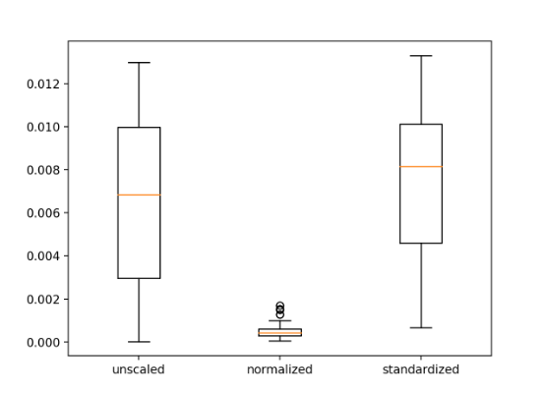
Key Term: 'Norm' (Layer Norm)
"Norm" stands for Layer Normalization. This is a crucial "helper" component.
Its job is to keep the numbers inside the network from becoming too large or too small during training.
Analogy: It's like the "volume control" on a stereo. It keeps all the signals in a stable, predictable range, which makes the model train much faster and more reliably.

Slide 8
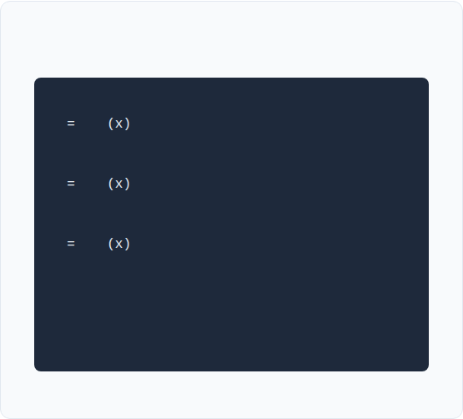

Inside a 'Head': Q, K, V
The Code (Conceptual)
The Library Analogy
Query (Q): Your search query.
(e.g., "I want to know about a fox")
# Q: What am I looking for?
Q
W_q
Key (K): The card catalog labels on each book.
(e.g., "fox," "dog," "cat")
# K: What do I have?
K
W_k
# V: What will I give you?
Value (V): The actual content inside the book.
(e.g., "The quick brown fox...")
V
W_v
# 1. Find Scores (Query x Key)
Attention matches your Query to the best Keys to retrieve the most relevant Values.
# 2. Get Weights (Softmax)
# 3. Get Context (Weights x Value)

Slide 9
Our Demo: From Text to Chatbot
2. SFT (Fine-Tuning)
4. Aligned Model
We teach it to be helpful by showing it specific Q&A examples.
The result is a helpful assistant that understands your document.
1. Pre-training
3. RLHF (Alignment)
The model learns language (grammar, facts) from your raw PDF text.
We "steer" the model to give better, safer answers using a Reward Model.

Slide 10

Questions?
Thank you for your attention.

Slide 11







Image Sources
https://machinelearningmastery.com/wp-content/uploads/2021/10/transformer_1.png
Source: machinelearningmastery.com
https://i.sstatic.net/7p5lu.png
Source: datascience.stackexchange.com
https://miro.medium.com/v2/resize:fit:834/1*c4e4MB8ECCAEApHihYZX0Q.png
Source: medium.com
https://machinelearningmastery.com/wp-content/uploads/2018/11/Box-and-Whisker-Plots-of-Mean-Squared-Error-With-Unscaled-Normalized-and-Standardized-Input-Variables-for-the-Regression-Problem.png
Source: machinelearningmastery.com

